Slide 1

A Sales Prediction Model Based on machine learning models
Group number: 4
group mempers :
mehdhar saggaf
ahmed Alqarni
Arwa alghmadi
malak Alshaikh

Slide 2



steps
adding predict sales to the real data
Using heat map to find most related columns to our target
Predict the sales in the real data
Check the missing values us isnull
Find the best Model
Data preprocessing and split
Check the NaN in the columns
Drop any row have NaN
Explore the data

Slide 3
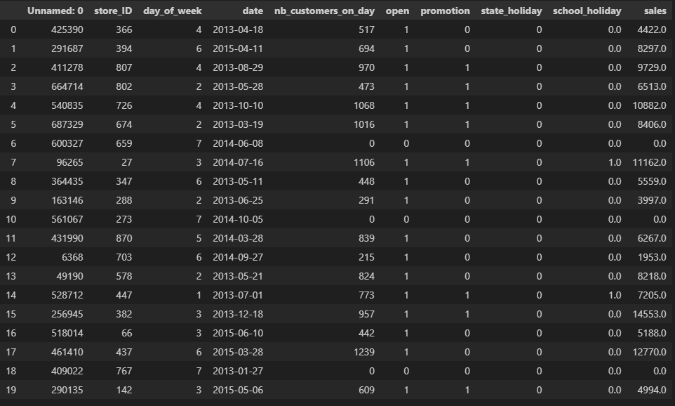
Explore the data

Slide 4
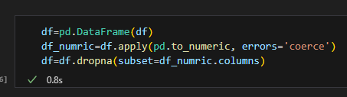
Check the NaN in the columns

Slide 5

Drop any row have NaN

Slide 6
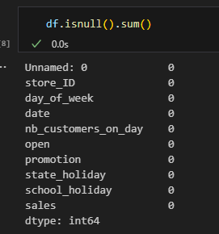
Check the missing values us isnull

Slide 7
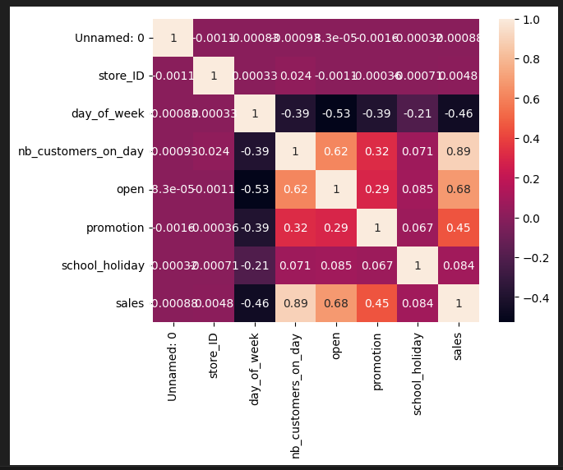
Using heat map to find most related columns to our target

Slide 8
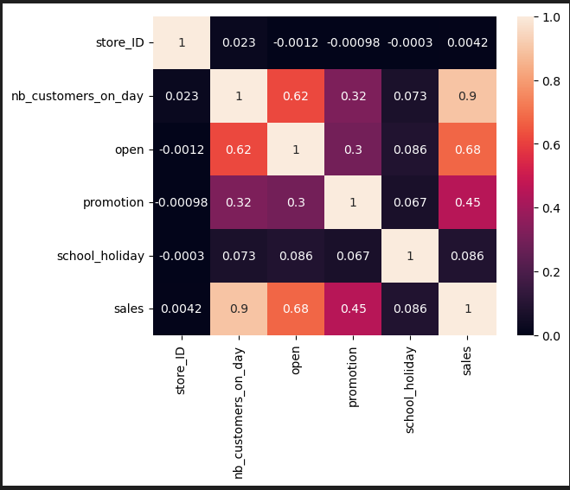
Using heat map to find most related columns to our target

Slide 9
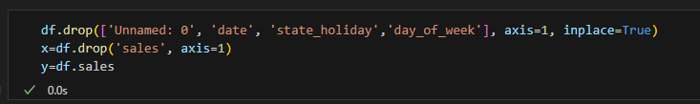
Data preprocessing and split

Slide 10
Find the best Model :
Random Forest Regressor
• knn model
• Decision Tree Regressor
• Linear regression

Slide 11
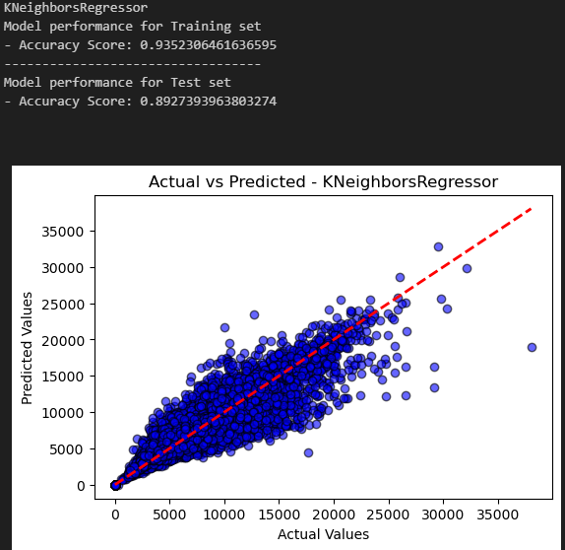
knn model

Slide 12
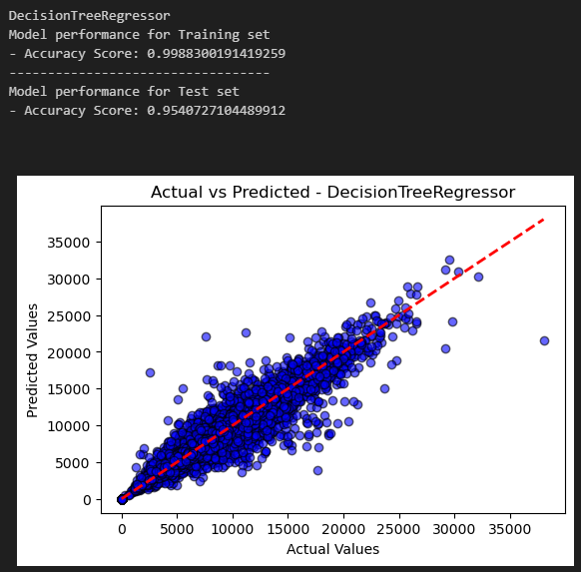
Decision Tree Regressor

Slide 13
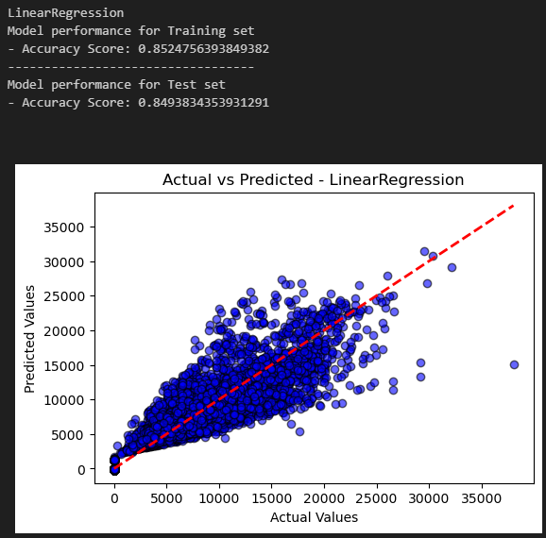
Linear regression

Slide 14
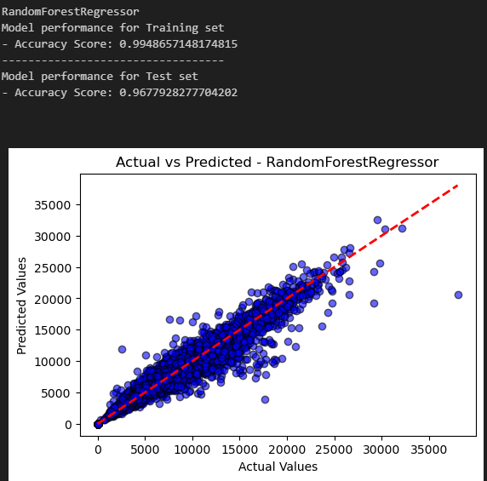
Random Forest Regressor

Slide 15
•We chose Random Forest Regressor because he give as the best accuracy with our data
Result of model selection
models | r2_score_test | r2_score_train
knn model | 89% | 93%
Decision Tree Regressor | 95% | 99.88%
linear regression | 84.9% | 85%
Random Forest Regressor | 96.77% | 99.48%

Slide 16
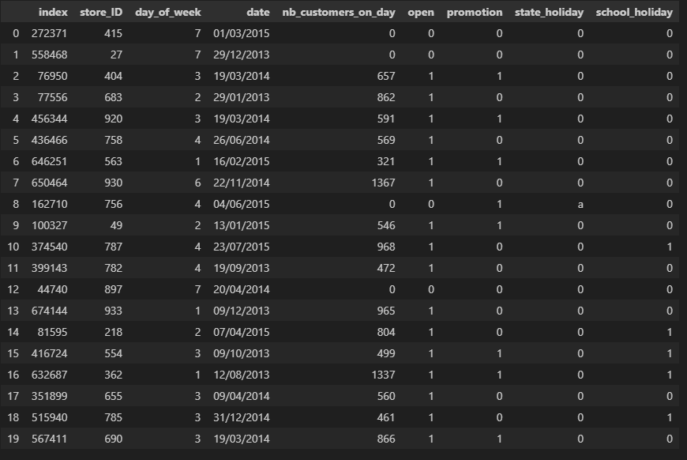
Predict the sales for the real data:
explore the real data:
dataset
model
accuracy

Slide 17
Predict the sales for the real data:
PREDICT FOR REAL DATA:
dataset
model
accuracy

Slide 18
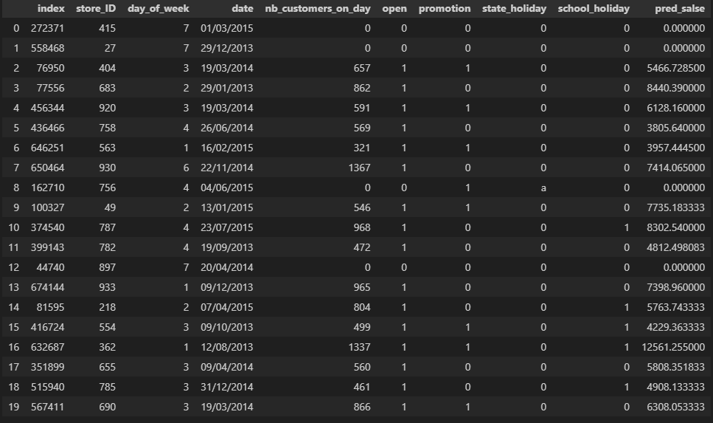
Adding predict sales to the real data:
explore the real data after adding sales prediction column :
dataset
model
accuracy

Slide 19


